Slide 1


EcoPath: Ai Integrated smart Traffic management system
Team Lead Name:- Pranjali Deshmane
Team Member 1:- Diksha Jaju
Team Member 2:- Prasad Mapari
Team Member 3:- Pranjali Deshmane
Team Member 4:- Yash Deshmukh
Mentor Name:-Sagar Yadav
College Name - Vishwakarma University
Notes:
Let's delve deeper into the exciting world of sustainability and AI.
In this chapter, we'll explore how artificial intelligence can be a powerful tool for addressing environmental challenges and promoting sustainable practices. We'll discuss specific applications of AI in various sectors and analyze its potential to drive positive change.
Get ready to discover the innovative ways AI is contributing to a more sustainable future!

Slide 2

Project Objectives
Problem Statement
Project Overview – Introduction
End Users
Wow Factor in Project
Modelling/Block Diagram/Flow of Project
Result/outcomes
Conclusion
Future Perspective
Notes:
Let's outline what you'll learn in this presentation.
By the end, you'll be able to:
Understand how AI helps solve problems like climate change, resource depletion, and biodiversity loss.
Identify key AI uses in energy efficiency, waste management, and climate change.
Analyze AI's role in sustainable agriculture and cities.
Evaluate AI's use in environmental monitoring using satellites, real-time data, and predictions.
Apply AI strategies in logistics and transportation to make them more sustainable.
Get ready to discover how AI can help create a greener future!

Slide 3
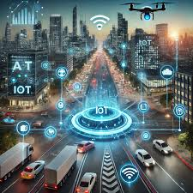
Problem Statement
Urban Growth & Traffic Jams: With rapid city growth, old fixed-time signals cannot manage heavy traffic properly.
High Fuel Use & Pollution: Idling at red lights increases fuel consumption, air pollution, and money loss.
Long Waiting at Signals: Vehicles often wait longer than needed, wasting time and slowing movement.
Road Safety Issues: More chances of accidents, frequent traffic violations, and rule-breaking.
Manual Monitoring Problems: Human-based monitoring is slow, tiring, and often full of errors
Notes:
Sustainability and AI
Sustainability is important because it helps meet our needs now and in the future. It includes protecting the environment, reducing pollution, and improving economic and social well-being.
AI can help us achieve sustainability. AI can process data, make predictions, and optimize systems to solve problems like resource management, environmental conservation, and energy efficiency.
Examples:
Smart grids: Reduce energy consumption.
Agriculture: Optimize water and fertilizer use.
Biodiversity: Monitor wildlife to protect biodiversity.
AI is a powerful tool for creating a more sustainable future.

Slide 4
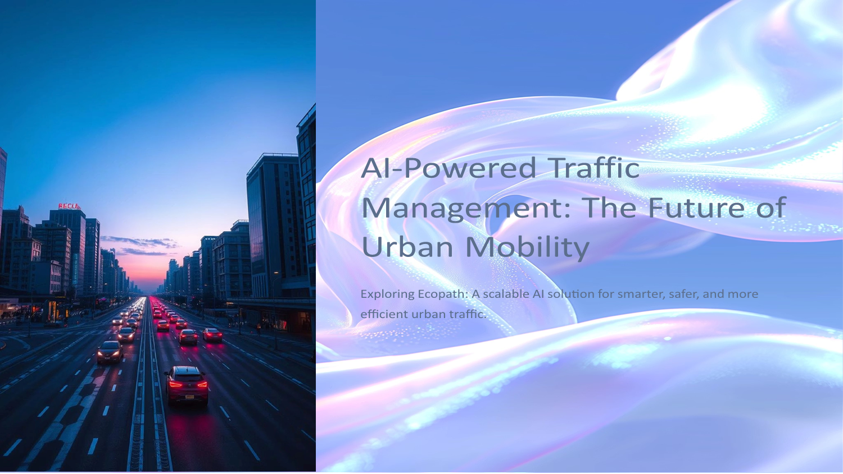
Project Overview - Introduction
Ecopath is an AI-powered traffic management system designed to make cities smarter and safer.
It uses YOLOv8 AI models to detect vehicles, red-light jumping, and lane violations in real-time.
The system employs ANPR (Automatic Number Plate Recognition) to identify violators quickly and accurately.
RTSP camera feeds are used for live video processing from roadside surveillance cameras.
Built with Flask, Docker, and Kubernetes, the system is scalable and can handle growing city needs.
A Next.js dashboard provides real-time monitoring, analytics, alerts, and live video streams to traffic authorities.
Notes:
Sustainability and AI
Sustainability is important because it helps meet our needs now and in the future. It includes protecting the environment, reducing pollution, and improving economic and social well-being.
AI can help us achieve sustainability. AI can process data, make predictions, and optimize systems to solve problems like resource management, environmental conservation, and energy efficiency.
Examples:
Smart grids: Reduce energy consumption.
Agriculture: Optimize water and fertilizer use.
Biodiversity: Monitor wildlife to protect biodiversity.
AI is a powerful tool for creating a more sustainable future.

Slide 5



End Users
Urban Planners
Commuters
Traffic Enforcement
Data-driven insights for city Planning
Reduced congestion and travel time
Automated violation detection
Optimization of traffic flow strategies
Support for smart city initiatives
Enhanced road safety
Instant alerts for rapid response
Smoother and more predictable
Efficient evidence collection
Notes:
Sustainability and AI
Sustainability is important because it helps meet our needs now and in the future. It includes protecting the environment, reducing pollution, and improving economic and social well-being.
AI can help us achieve sustainability. AI can process data, make predictions, and optimize systems to solve problems like resource management, environmental conservation, and energy efficiency.
Examples:
Smart grids: Reduce energy consumption.
Agriculture: Optimize water and fertilizer use.
Biodiversity: Monitor wildlife to protect biodiversity.
AI is a powerful tool for creating a more sustainable future.

Slide 6

Wow Factors in Project
Precision Detection
~92% accuracy in real-time violation detection.
Instant Alerts
Latency of <2 seconds from detection to alert.
Modular & Scalable
Microservices + Kubernetes ensures robust
and flexible desing
Eco-Friendly
Adaptive signal logic significantly reduces
emissions
Notes:
Sustainability and AI
Sustainability is important because it helps meet our needs now and in the future. It includes protecting the environment, reducing pollution, and improving economic and social well-being.
AI can help us achieve sustainability. AI can process data, make predictions, and optimize systems to solve problems like resource management, environmental conservation, and energy efficiency.
Examples:
Smart grids: Reduce energy consumption.
Agriculture: Optimize water and fertilizer use.
Biodiversity: Monitor wildlife to protect biodiversity.
AI is a powerful tool for creating a more sustainable future.

Slide 7
Modelling/Block Diagram/Flow of Project
Eco-path Project Flow
YOLOv8 Detection
Database Logging
Detect vehicles and
Store events and generate
violations
alerts
Roadside IP Cameras
ANPR Module
Next.js Dashboard
RTSP video capture of traffic
Identify number plates
Visualize live feeds and
reliably
analytics
The Ecopath system processes traffic data from capture to actionable insights with high efficiency and robust scalability.
Notes:
Sustainability and AI
Sustainability is important because it helps meet our needs now and in the future. It includes protecting the environment, reducing pollution, and improving economic and social well-being.
AI can help us achieve sustainability. AI can process data, make predictions, and optimize systems to solve problems like resource management, environmental conservation, and energy efficiency.
Examples:
Smart grids: Reduce energy consumption.
Agriculture: Optimize water and fertilizer use.
Biodiversity: Monitor wildlife to protect biodiversity.
AI is a powerful tool for creating a more sustainable future.

Slide 8
Result/Outcomes
Violation Detection Accuracy: 91–92% during tests.
Low Error Rate: Only 3.2% false positives.
Processing Speed: Each frame processed in 0.18 seconds.
Quick Alerts: Less than 2 seconds from detection to alert.
System Reliability: 99.7% uptime in real-world tests.
Additional Feature: Automatic accident detection and alerting to authorities.
Notes:
Sustainability and AI
Sustainability is important because it helps meet our needs now and in the future. It includes protecting the environment, reducing pollution, and improving economic and social well-being.
AI can help us achieve sustainability. AI can process data, make predictions, and optimize systems to solve problems like resource management, environmental conservation, and energy efficiency.
Examples:
Smart grids: Reduce energy consumption.
Agriculture: Optimize water and fertilizer use.
Biodiversity: Monitor wildlife to protect biodiversity.
AI is a powerful tool for creating a more sustainable future.

Slide 9
Conclusion
Ecopath provides a scalable, intelligent, and automated traffic management system.
It improves road safety, reduces congestion, and saves time for commuters.
Offers real-time insights and automatic enforcement to authorities.
Supports smart city infrastructure with an eco-friendly, data-driven approach.
Notes:
Sustainability and AI
Sustainability is important because it helps meet our needs now and in the future. It includes protecting the environment, reducing pollution, and improving economic and social well-being.
AI can help us achieve sustainability. AI can process data, make predictions, and optimize systems to solve problems like resource management, environmental conservation, and energy efficiency.
Examples:
Smart grids: Reduce energy consumption.
Agriculture: Optimize water and fertilizer use.
Biodiversity: Monitor wildlife to protect biodiversity.
AI is a powerful tool for creating a more sustainable future.

Slide 10




Future Perspective
Scaling Eco-path for Sustainable Cities
Better ANPR: Improve performance during night-time and bad weather.
Automated E-Challan: Directly integrate with city databases for automatic fine generation.
AI Risk Prediction: Use AI to predict risks based on time, weather, and special events.
Diverse Training Data: Train AI with conditions like fog, rain, and night traffic for more accuracy.
Full Automation: Move towards fully automated traffic systems for sustainable and safer cities.
Our roadmap includes continuous improvement and strategic integrations to make Ecopath the cornerstone of future urban
mobility.
Enhanced Low-Light ANPR
Improving performance in challenging night and weather conditions.
Automated E-Challan Integration
Seamlessly link with municipal databases for fine enforcement.
AI-Based Risk Prediction
Proactive hazard identification based on real-time factors.
Full End-to-End Automation
Towards complete autonomous and sustainable urban traffic management.
Notes:
Sustainability and AI
Sustainability is important because it helps meet our needs now and in the future. It includes protecting the environment, reducing pollution, and improving economic and social well-being.
AI can help us achieve sustainability. AI can process data, make predictions, and optimize systems to solve problems like resource management, environmental conservation, and energy efficiency.
Examples:
Smart grids: Reduce energy consumption.
Agriculture: Optimize water and fertilizer use.
Biodiversity: Monitor wildlife to protect biodiversity.
AI is a powerful tool for creating a more sustainable future.

Slide 11
REFERENCES
Frouke Hermens, “Automatic Object Detection for Behavioural Research using YOLOv8,” Behavior Research Methods, Springer Nature, 2024.
Ihtisham Ali, Khalid Mahmood Malik, Mazhar Ali Khan, Farrukh Aslam Khan, “Intelligent Traffic Management System using Video Surveillance and
Queue- based Control Algorithm,” International Conference on Frontiers of Information Technology (FIT), IEEE, 2015.
Mohammed Shariff, M. Kavyashree, D. Hamsalekha, “Vehicle Number Plate Detection Using Python and OpenCV,” International Conference
on Advance Computing and Innovative Technologies in Engineering (ICACITE), IEEE, 2021.
S. Agnes Joshy, M. Dhana Sakthi, C. Jenit Catherin, T. Danamaliga, “Traffic Management System Using Machine Learning,” International Journal
of Novel Research and Development (IJNRD), Vol. 9, Issue 4, April 2024.
Moahaimen Talib, Ahmed H. Y. Al-Noori, Jameelah Suad, “YOLOv8-CAB: Improved YOLOv8 for Real-time Object Detection,” Karbala International Journal of Modern Science , Vol. 10, 2024.
Pragati Satpute, Dipti Patil, “Object Detection Using YOLOv8,” International Journal of Creative Research Thoughts (IJCRT), Vol. 12, Issue 12, December 2024.
Ratan Kumar, “AI for Traffic Management: An Analysis of Machine Learning Algorithms and Real-World Applications,” Research Proposal , Delhi Skill and Entrepreneurship University, March 2023.
Zhang Lei, Shi Yigong, “Intelligent Traffic System Using Machine Learning Techniques: A Review,” International Journal of Research Publication and Reviews, Vol. 4, No. 5, pp. 1457–1461, May 2023.
Dr. A. Ravi, R. Nandhini, K. Bhuvaneshwari, J. Divya, K. Janani, “Traffic Management System Using Machine Learning Algorithm,” International Journal of Innovative Research in Technology (IJIRT), Vol. 7, Issue 11, April 2021.

Slide 12
Thank You
Notes:
Thank You !!

